Slide 1

Zulip New Features
BY: Amira, Shristi, Emily, Oriana

Slide 2
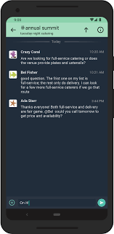
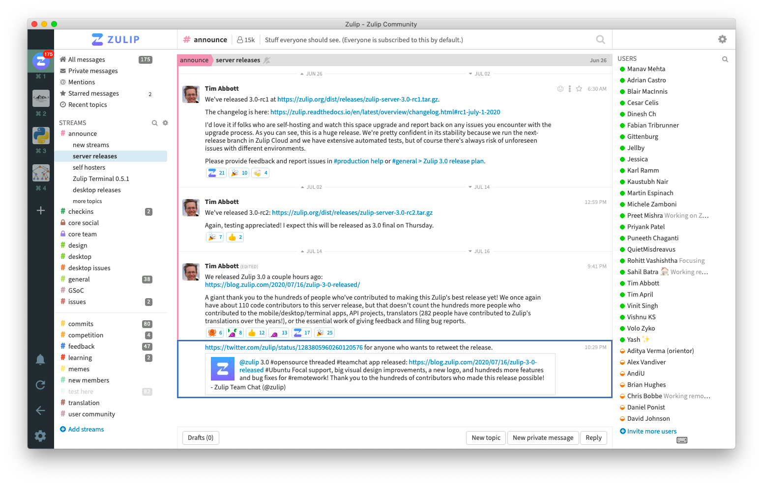
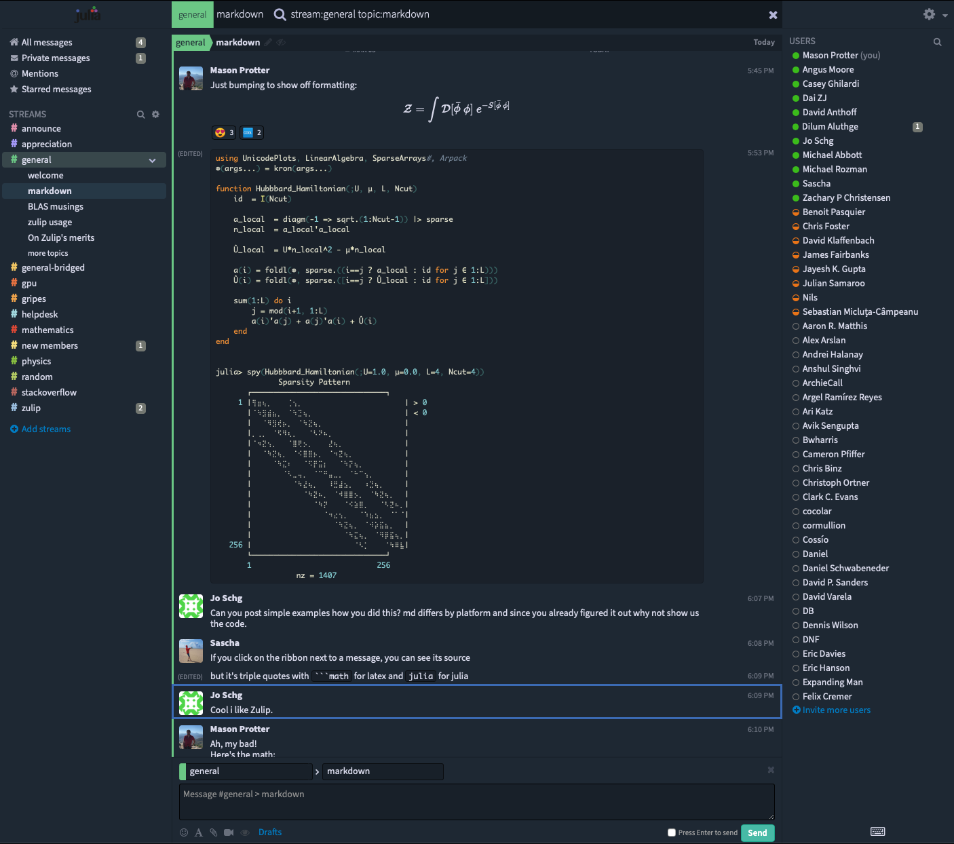
Introduction
Amira
Zulip is an open-source platform that allows users to engage conversations and provides collaborative tools.
New features
Work Status
Set Location
Page Customization
Notification

Slide 3
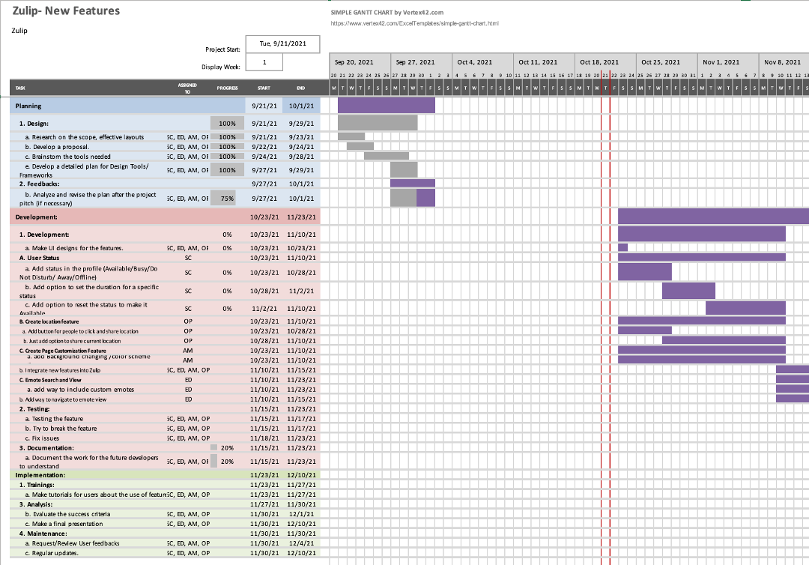
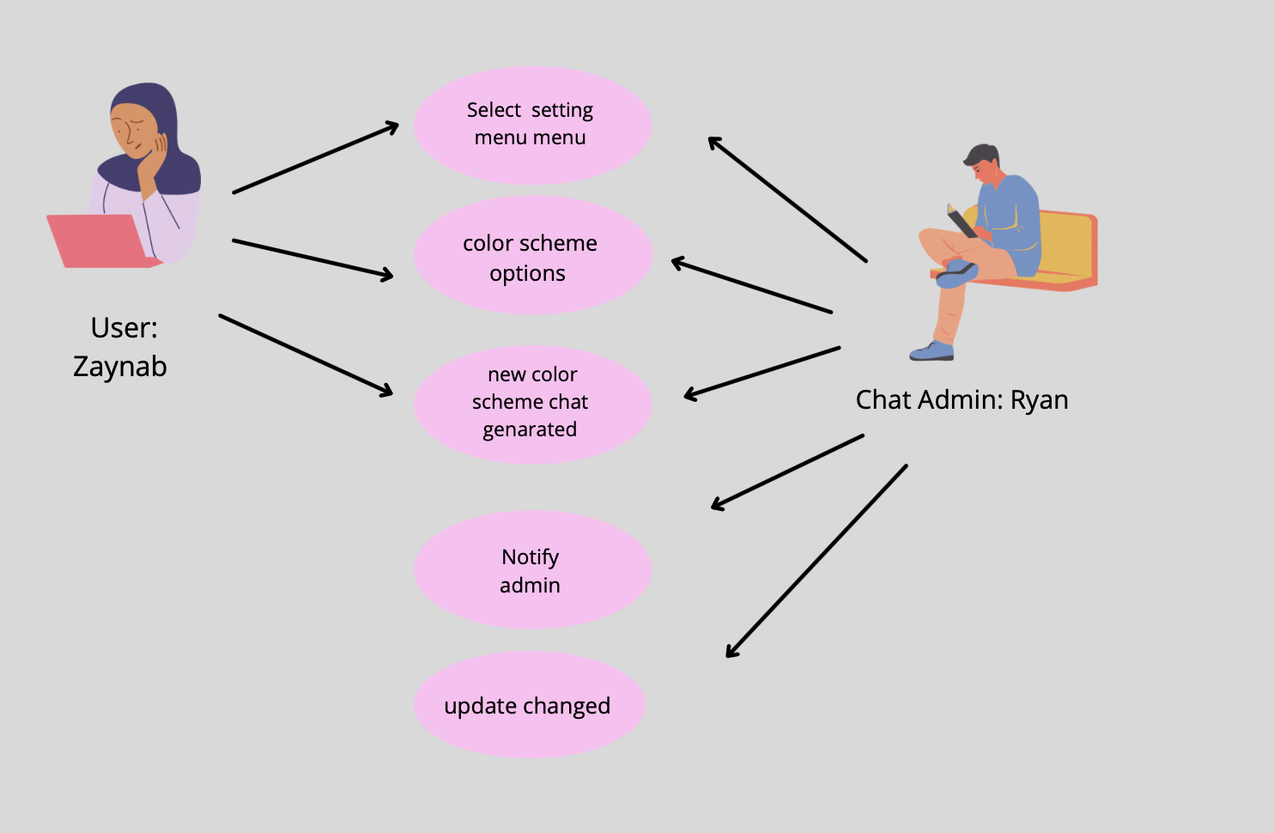
Work performed so far
Amira
Planning and project management / Gantt chart
User stories and scenarios for each features.
Functional and non-functional requirements
System Modeling

Slide 4
What has gone well
Emily
Utilizing Teams to communicate when schedules are too busy for meetings
Team lead takes charge when it is their turn
Able to plan features well

Slide 5
Challenges
Emily
Busy Schedules
Procrastination

Slide 6
Plan for the remaining work
Shristi
Present this idea to the developers of Zulip
Feedbacks from users if they would like to see these features
Continue to brainstorm features along with different scenarios
Documentation on how to use these features
Evaluate our success criteria

Slide 7
System Modeling – Context Model
Page Customization
Light Mode
Zulip Application System
Notification System
Dark Mode
Send user’s current location
Send notification
Activity Center
Share Location

Slide 8
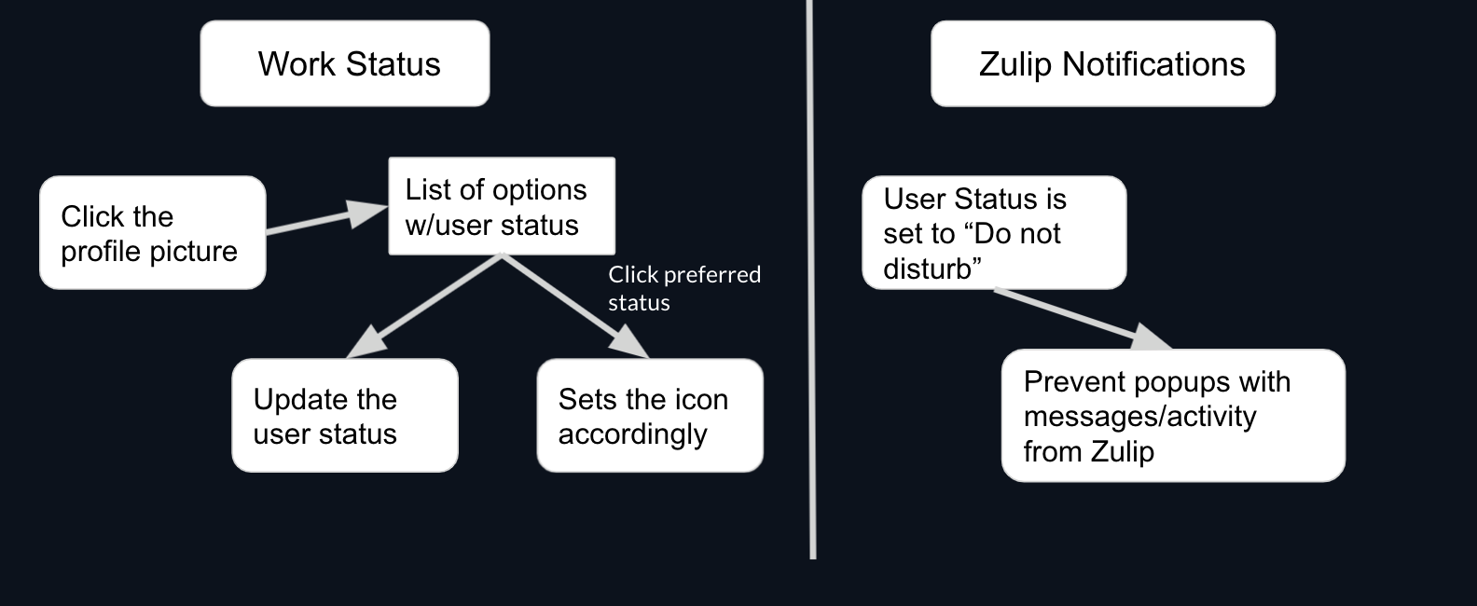
User Status- Process Model

Slide 9
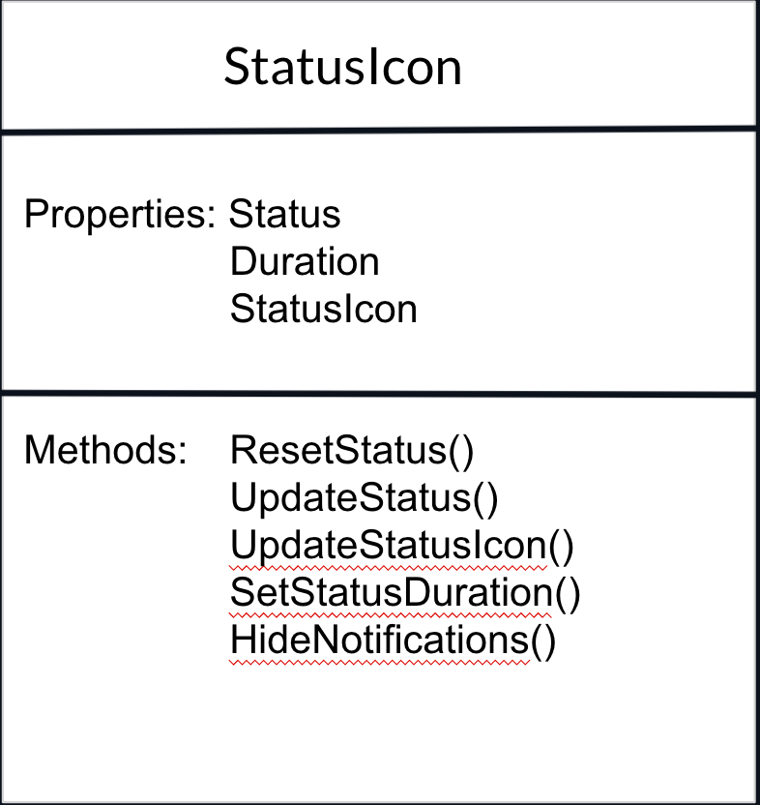
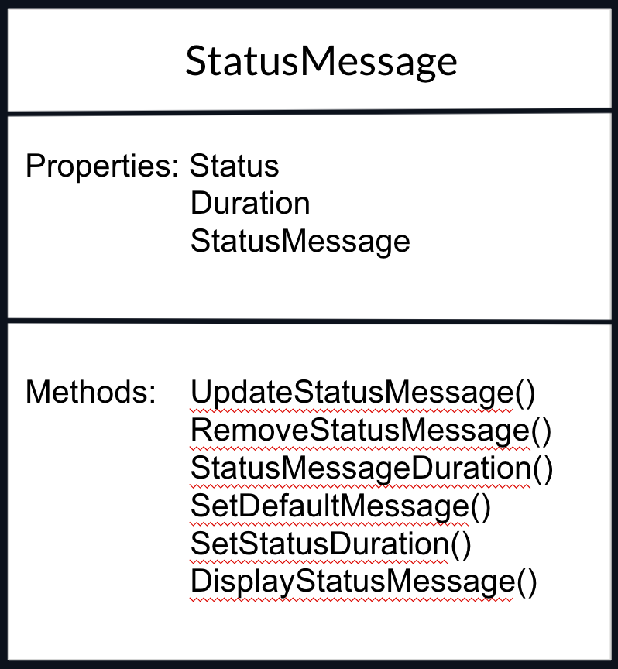
User Status - Class Diagram

Slide 10
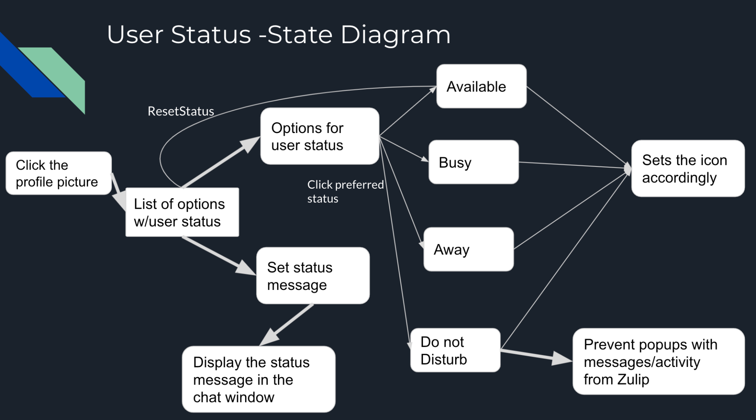

Slide 11
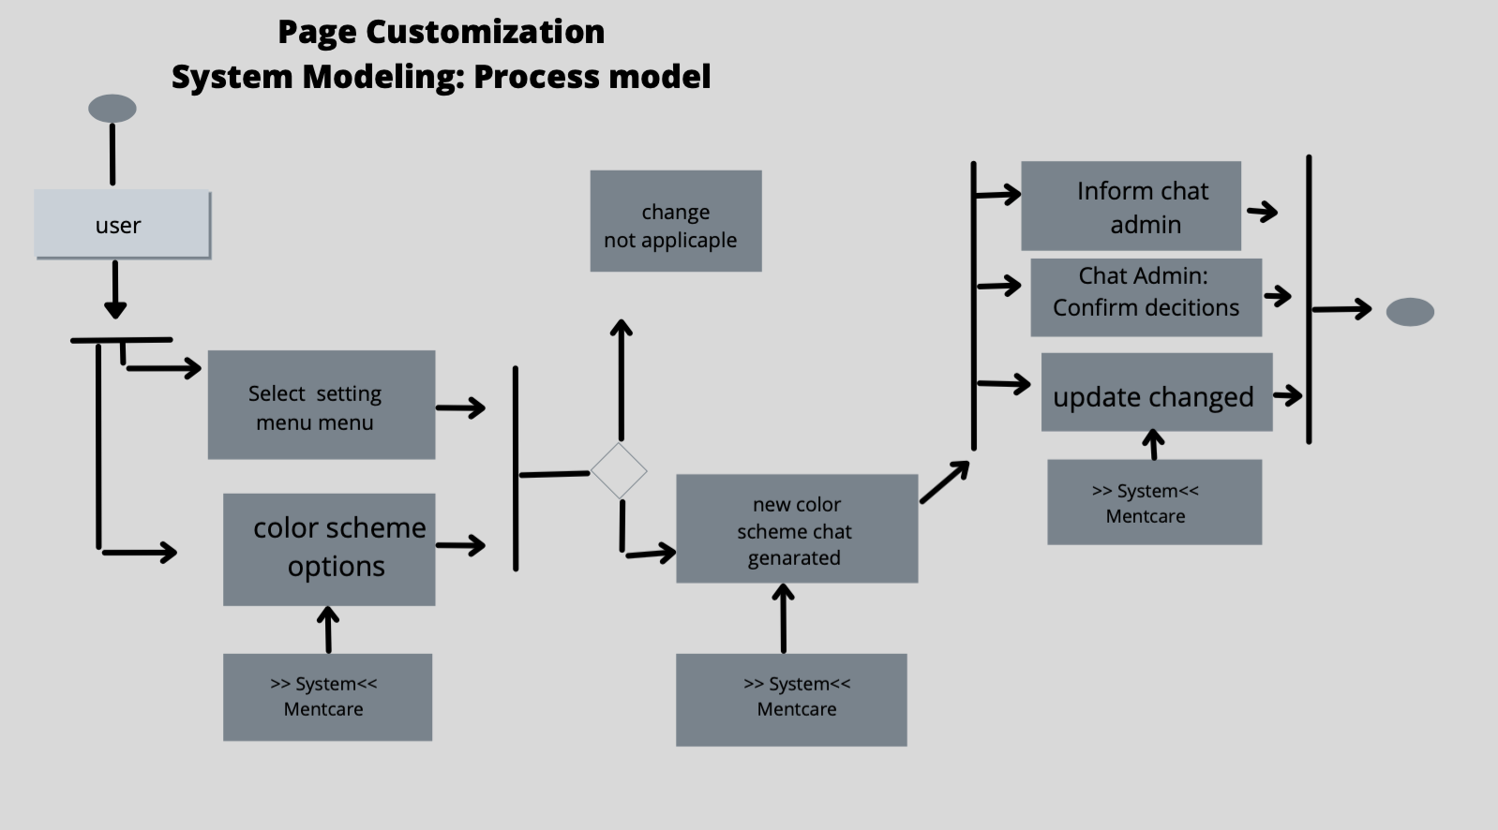

Slide 12
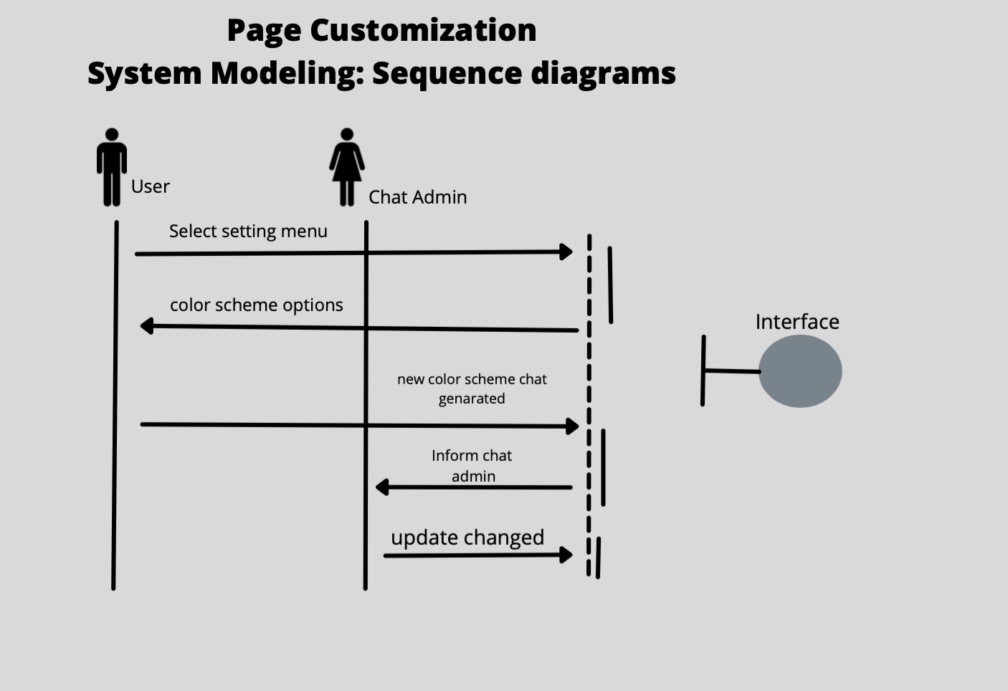

Slide 13
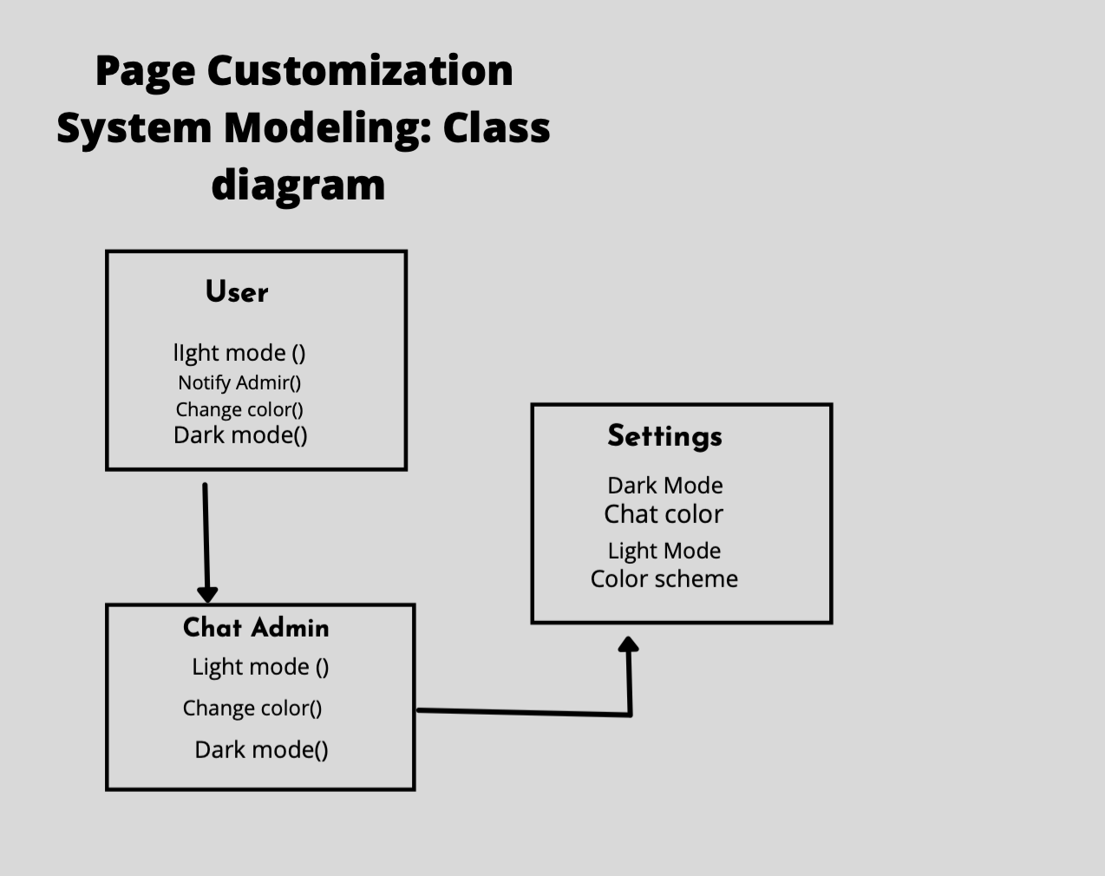

Slide 14
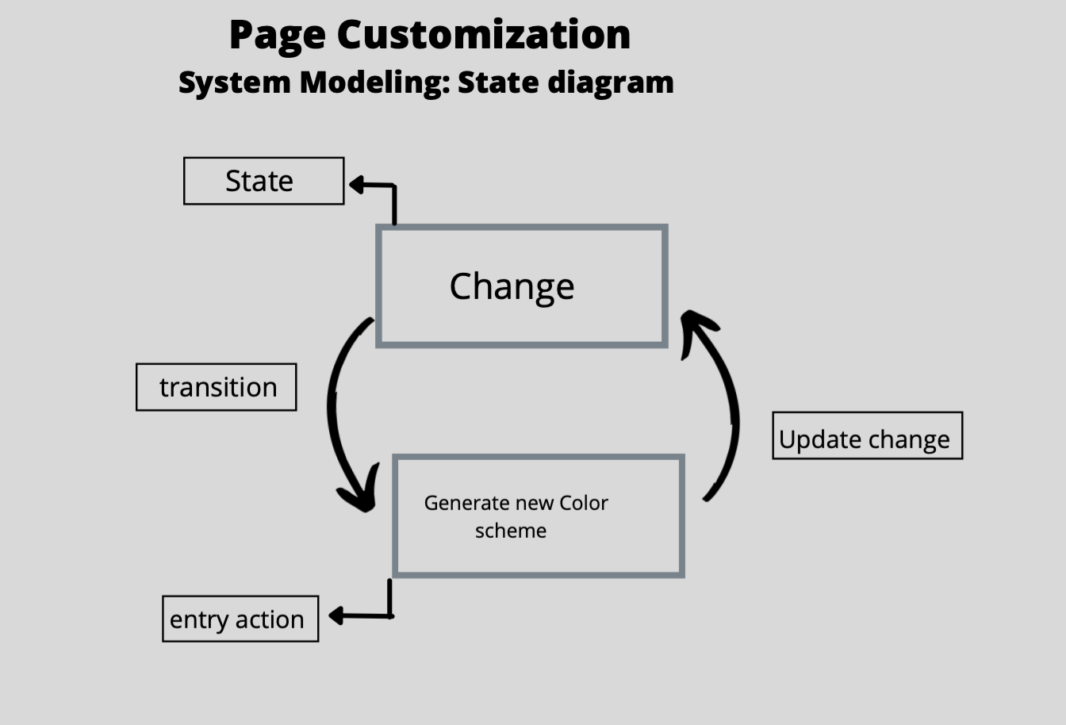

Slide 15
Location-Process Model
Send location
Select desired contact to send location
Press location button
System process request
System takes the user’s current location
Current location of user is sent

Slide 16
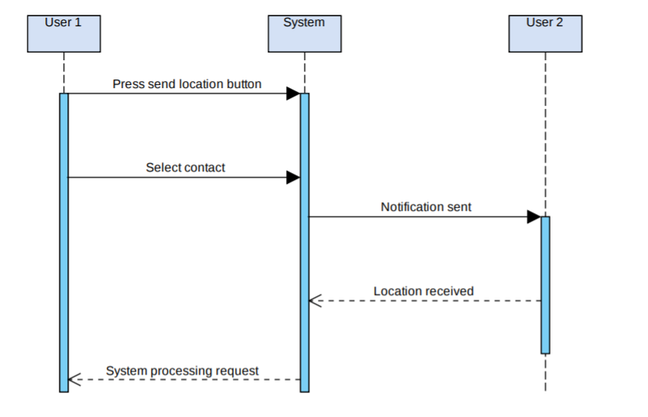
Location-Sequence Diagram

Slide 17
Location-Class Diagram
SearchLocation
Properties: Location CurretLocationStatus date : Date
getDate(): Date getCurrentLocationStatus() getCompassDegrees() getSatellite() updateLocation()
LocationNotification
Properties: Location MessageStatus LocationMessage
sendLocation() checkContact() checkMessageStatus() receiveLocation() getIncomingMessage()

Slide 18
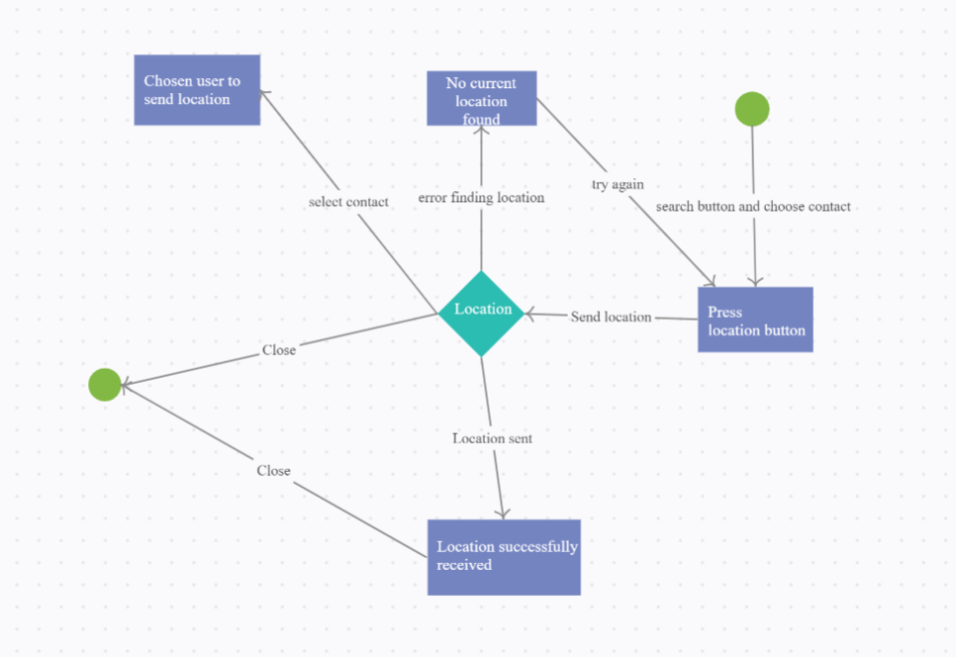
Location-State Diagram

Slide 19
Activity Center - Process model
User A reacts to User B’s Post
System Process emote request
Display A’s Reaction
Check if B has emote notifications enabled
Send B Notification

Slide 20
Activity Center - Sequence Diagram
User A
System
User B
React
Display reaction on B’s Activity Center
Send B Notification
Confirm Notification Sent
Confirm reaction displayed

Slide 21
Activity Center - Class Diagram
Class ActivityCenter
//Properties
Emotes
Notifications
User
//Methods
displayEmotes()
loadPage()
Send Notification()

Slide 22
Conclusion
Elevate Zulip by adding project management tools such as
Work Status
Share Location
Page Customization
Notification
Estimated Budget & Time:
$40,000
12/10/21

